Slide 1



Digital
Games
Game Design - 201
Tue 2-4:45pm C-356
Prof. A McClure

Slide 2
Level Up: Women in Video Games
NYU
Friday, March 4th 7pm
http://www.fusionfilmfestival.com/
Physical Computing - Anything Can Be A Controller
Microsoft
March 16th 6:30-8:30pm
https://www.eventbrite.com/e/class-physical-gaming-anything-can-be-a-controller-free-tickets-21360659307?mc_cid=ac6a907a1c&mc_eid=4d7427265d

Slide 3
Last week

Slide 4
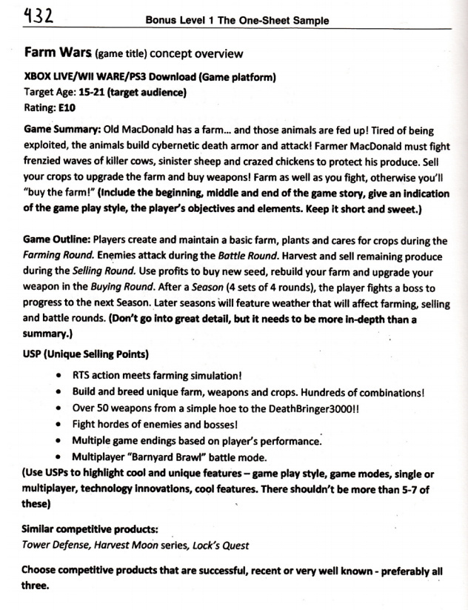
One-Sheet Example
link

Slide 5
One-Sheet Outline
Title
Game Platform
Target Audience
Rating
Game Summary
Game Outline
USP (Unique Selling Points)
Similar Competitive Products / Precedents
Notes:
you might not know everything for the pitch, which is OK.
this is a market based approach. feel free

Slide 6
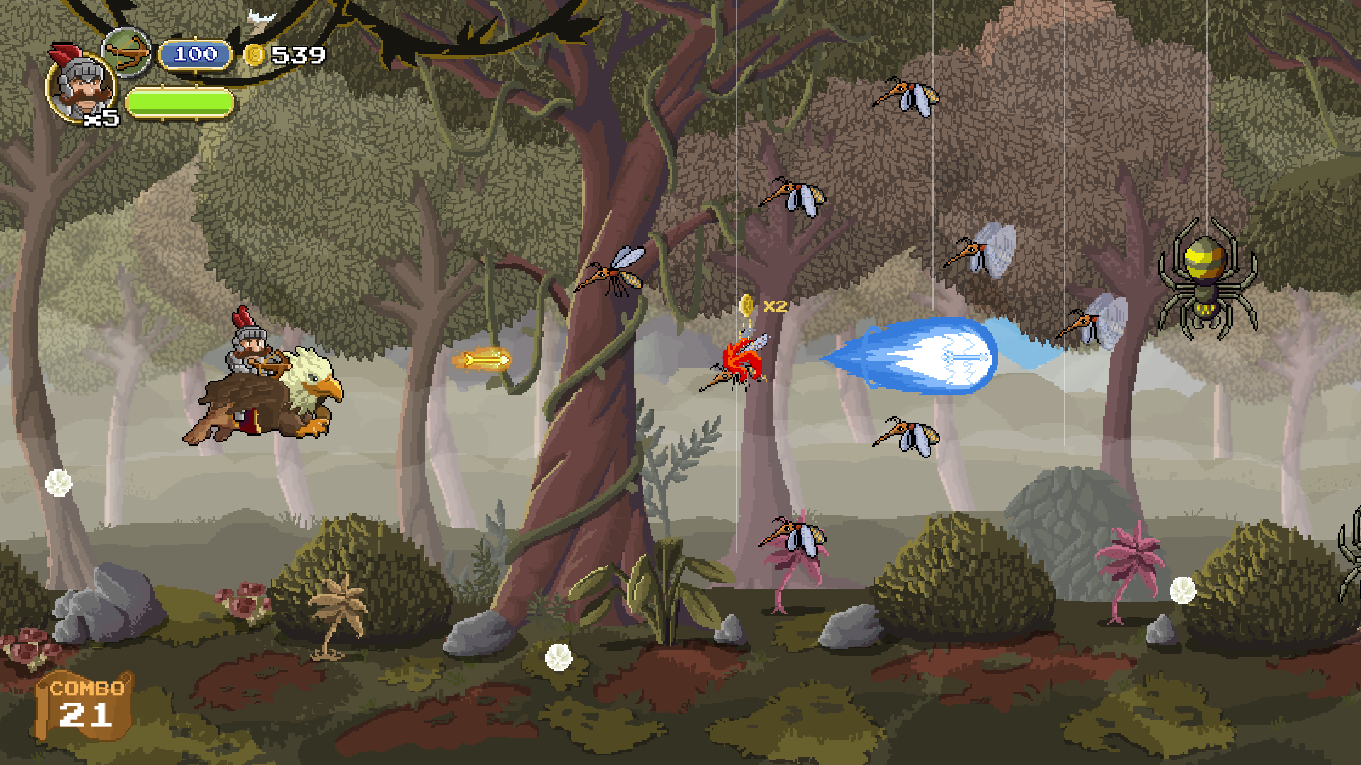
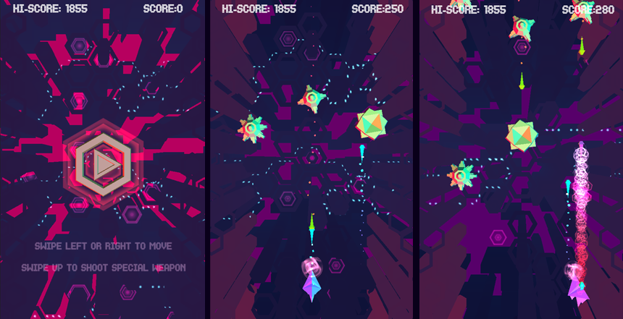
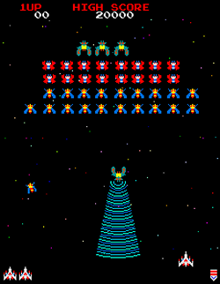
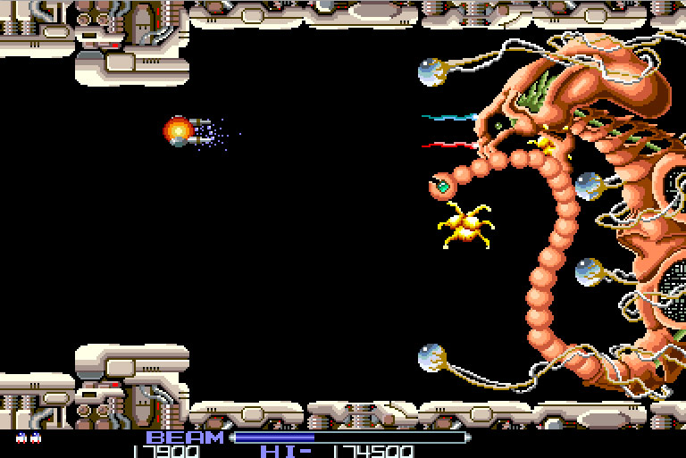
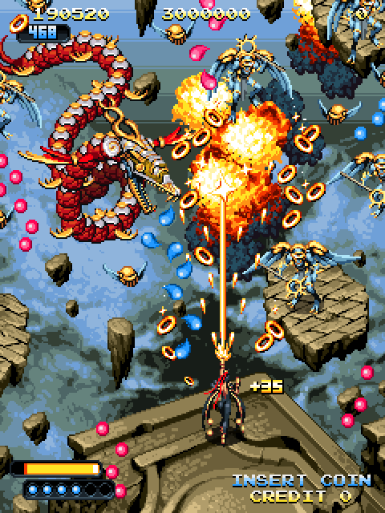
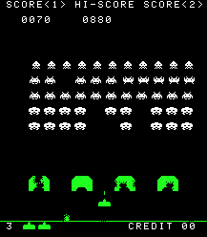
Notes:
what do these have in common?
-on rails
-projectiles

Slide 7
LAST WEEK’s HOMEWORK
PLAY Increpare’s Slave of God seizure warning!!
READ Art Games chapter from Works of Game (Sharp)
READ Rock Paper Shotgun - Photorealism is Crucial
READ Video Games Can Never be Art (Roger Ebert)
WRITE RGR3 (500 word minimum)
What is your reaction to Slave of God?
Can games be art?
Do pretty graphics matter?
Should games be realistic?
etc.

Slide 8
Warm seat discussions!
wait, what?

Slide 9
Half the class moves to the next seat every 2 minutes!

Slide 10
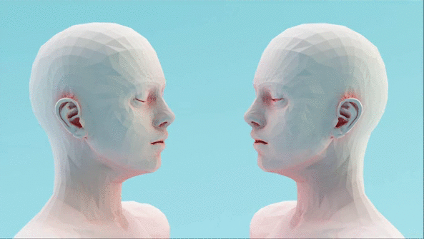
GAMES AS AN
EXPRESSIVE
MEDIUM

Slide 11
STYLE is IMPORTANT

Slide 12
STYLE is SUBSTANTIVE

Slide 13
REALISM can be more than just PHOTOREALISM

Slide 14
Essentialize experience
how can you find the right metaphors?
Notes:
truth of the subjective experience

Slide 15
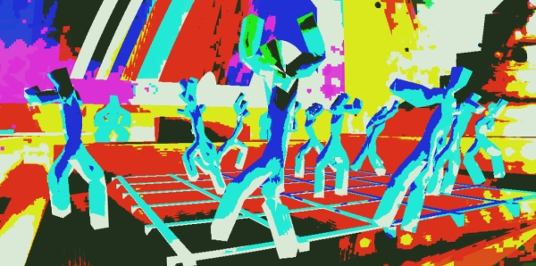

Slide 16

Wtf happened last night?
All I remember...
vivid colors, deep house beats, everything spinning, human connection… what was their name again?

Slide 17
COMMUNICATING EMOTION

Slide 18
Establishing a unique experience
and forgetting that you’re playing a game

Slide 19
GAME
FEEL

Slide 20
Game feel as the experiential sensation of a game

Slide 21

Game Feel
What does Tekken feel like?
Pac-man?
Katamari Damacy?
book link

Slide 22
“The five most common experiences of game feel are:
● The aesthetic sensation of control
● The pleasure of learning, practicing and mastering a skill
● Extension of the senses
● Extension of identity
● Interaction with a unique physical reality within the game”

Slide 23
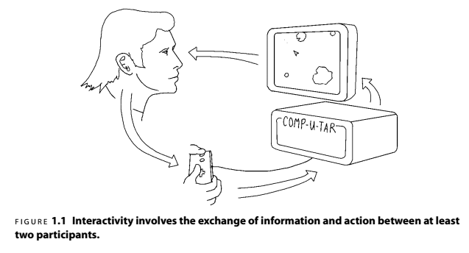
Notes:
simple feedback loop

Slide 24
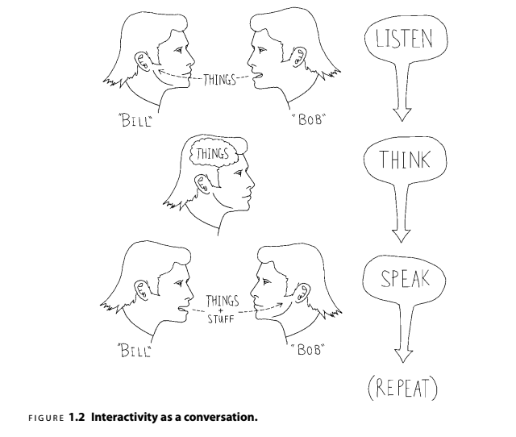
Notes:
The conversation in Figure 1.2begins when one participant, Bob, speaks. The
other participant, Bill, listens to what was said, thinks about it, formulates a response
and speaks in return. Now it’s Bob’s turn to listen, think and speak, and so on. In
Crawford’s model, a computer replaces one of the participants, “ listening ”to the
player’s input via the input device, thinking by processing that input and changing
system state and “ speaking ”via the screen and speakers ( Figure 1.3 ).

Slide 25
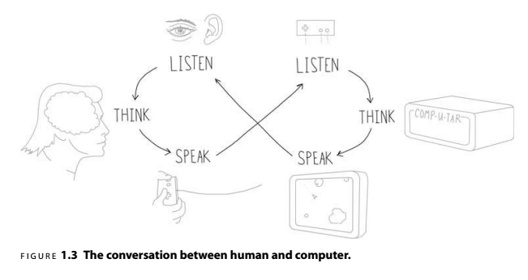
Notes:
quickest way to break a game, unintuitive controls

Slide 26
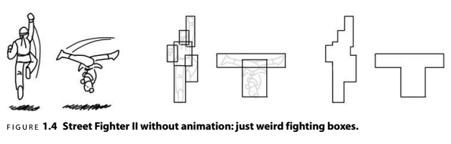

Slide 27
Control Interface Evolution
evolving the illusion

Slide 28


Slide 29
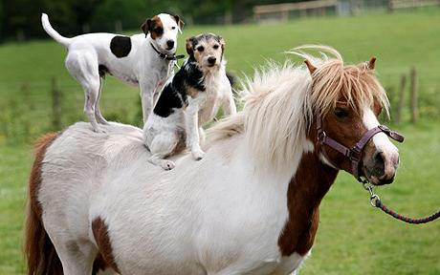
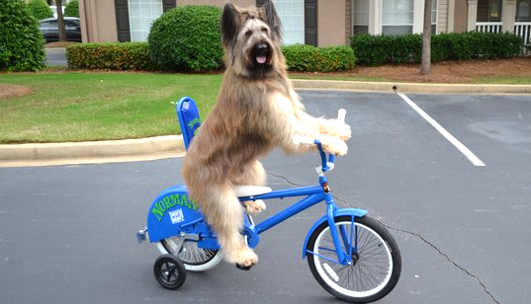

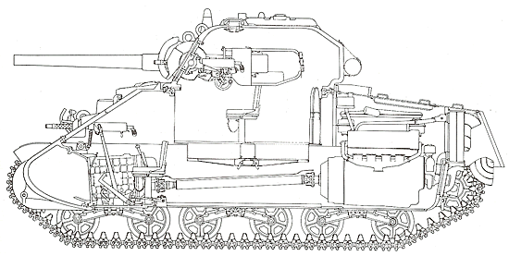
vs
vs
vs
vs

Slide 30

you are the car
“that @#$% hit me!”

Slide 31

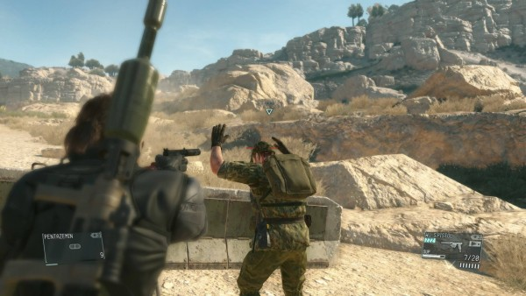
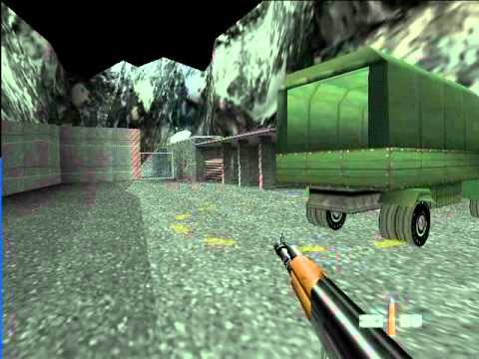
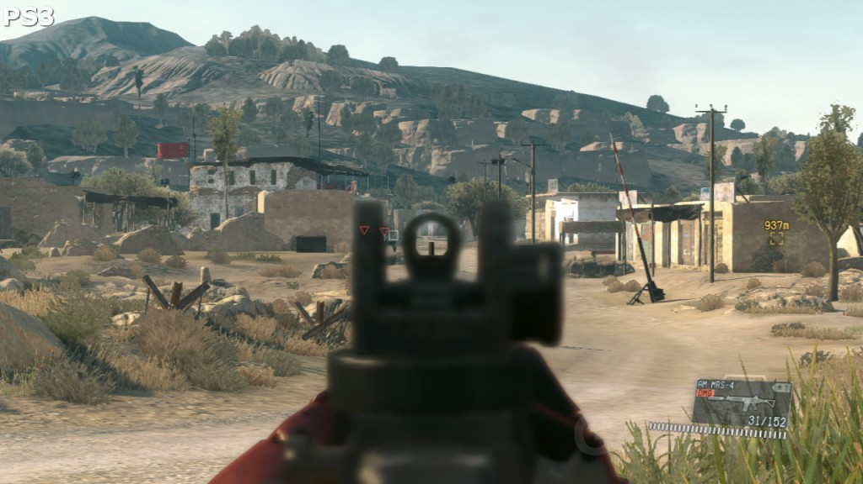
vs

Slide 32
fluid, harmonious
and natural

Slide 33


Make your games juicy!
subtle details make all the difference

Slide 34
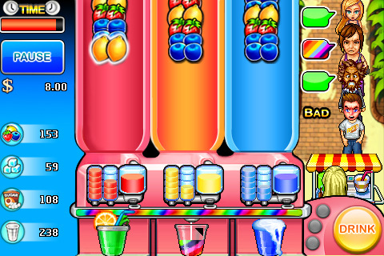

Slide 36
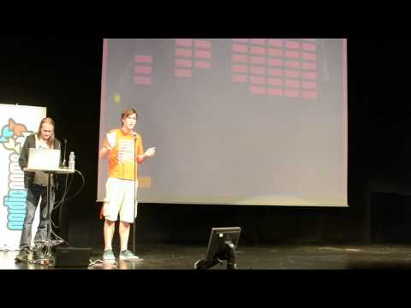

Slide 37
HOMEWORK
Game pitches -- Week 5 (3/8)
when is your team meeting?

